Slide 1
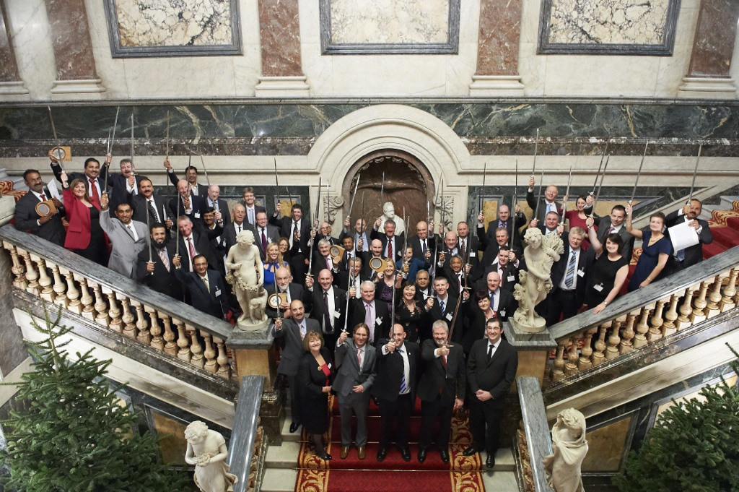
Journey to health and safety excellence St Leger Homes

Slide 2
St Leger Homes – who are we
Audit Commission excellent rated ALMO with 700 employees.
Set up by Doncaster Council in 2005 to manage 21,000 council homes and deliver a major programme of investment to bring homes up to the Decent Homes Standard.
We operate as not-for-profit limited company.
We have our own management board and work in partnership with Doncaster Council to deliver services.
We have recently expanded to take on delivery of additional services for the Council including housing options and homelessness.
Notes:
2007 was a pre-inspection and gap analysis 2008 Audit 3 star

Slide 3
Health and Safety Excellence – where we were
2007 British Safety Council 2 star – reality check!
Inherited large, unwieldy health and safety management system.
Lack of real engagement from managers and team leaders.
Perception that safety not aligned to business priorities.
Lack of engagement from trades and technical staff with safety accreditation systems such as CSCS.
Sometimes strained relationships with the Council’s Safety Team and other partner organisations.
Frustrations within the safety team due to lack of progress.
Notes:
2007 was a pre-inspection and gap analysis 2008 Audit 3 star

Slide 4
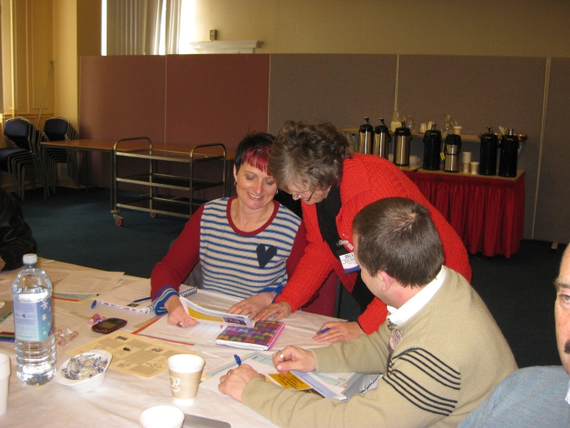
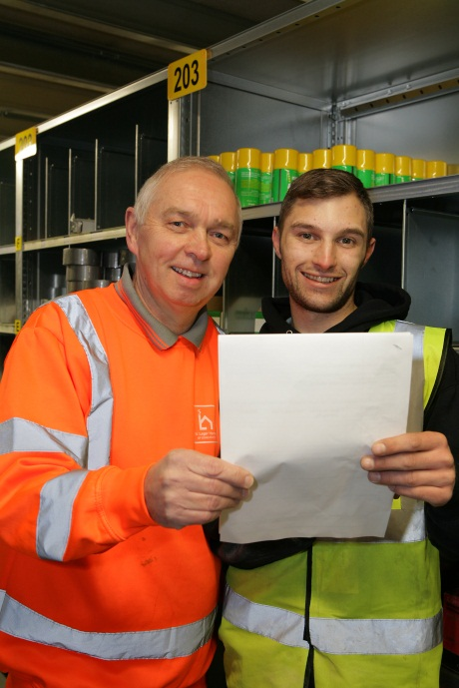
Health and Safety Excellence – where we are now
British Safety Council 5 Star Award 2011, 2012, 2013 awaiting our 2014 result.
Business and safety priorities aligned through a three year rolling health and safety strategy.
Strong Board, Chief Executive,senior management and trade union support.
Robust, streamlined safety management
systems.

Slide 5
Be the change you want to see ………….
We wanted to change staff behaviour and attitude to safety.
We realised our own attitude and behaviour had to change first.
Team away day led to our first Health and Safety strategy.
Once adopted the strategy gave focus and encouraged buy in.
Improved communication, engagement and recognition.
video clip courtesy of Eminex

Slide 6
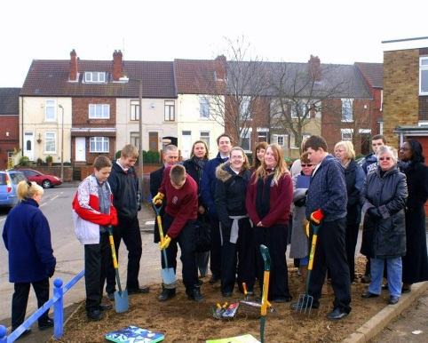
Success Story – CSCS
Supported by UCATT and Preston College.
Trade employees 20% in 2012 to 76% now.
Managers and support staff 95% have CSCS card.
Aim is to achieve 100%.
Bureaucracy has been biggest barrier.
Benefits have been huge.
Success Story – stress management
Overcoming outdated thinking and misconceptions.
Encouraging people to talk.
Work and non-work related stress.
Risk assessment ,tailored support, training for managers, recruitment, resilience building.

Slide 7
Success Story – embracing change
Change management high on the HSE and
British Safety Council agendas.
Programme praised by BSC Auditor.
Integration of new services from the Council
and 37 transferring employees.
Workshops jointly delivered with external consultancy Eminex using Who Moved My Cheese materials.
Target group included existing and new staff.
Addressed behavioural and emotional aspects of change.
Excellent buy in – impressive results.

Slide 8
Success story – site management
More in-house decency work.
CDM awareness.
Site management arrangements.
Formalisation of roles – chargehand posts created.
Inspection.
Success story – engagement
Trade union involvement.
Employee training.
Strong stakeholder relationships.
Safety campaigns with staff and tenants.
Thank you cards.

Slide 9
What next ……………
Improved accident investigation.
Better management of insurance claims.
More work on resilience building and change management.
Celebrate our success!
Video clip courtesy of Eminex

