Slide 1
Who do the public trust?
The democratic case for in house council services
Paul Smith Director Government and Public Sector Survation

Slide 2
Three ways this presentation will help you
Public trust you more to run services
They want to “be in control” of public services
National benchmarks based on their needs to be a new model of local council public services.
Page Title
Presentation Title

Slide 3
Introduction and Background
Survation were asked by the Association for Public Service Excellence APSE to provide a public opinion survey of attitudes to local neighbourhood services in 2017, covering the range of council services that would appear in their local area. Most questions mirrored questions asked in 2016.
Polling was conducted via online panel between 15th – 20th September 2017.
Data were weighted by age, sex, region, household income, education, 2017 GE vote and 2016 EU Referendum vote to be representative of all UK adults aged 18+.
The overall sample size was 1,634, including booster samples in Northern Ireland & Wales to ensure sub-samples of at least 100 persons in those regions.
Page Title
Presentation Title

Slide 4
Key continuity: Trust and taxes remain high
As in 2016, Trust in Councils and Councillors is high relative to Government ministers and Private Companies
· Five times as many still trust the local Council over the Government to make decisions about how services are delivered provided in your local area
· Eight times as many trust local councillors over government ministers to make decision about their local area
· Five and half times as many trusted the council to provide services in their local area over a private company with people trusting the council 7.5 times more than the government.
79% would like the government to give more money to local councils to spend at the local level for services that are their neighbourhood.

Slide 5
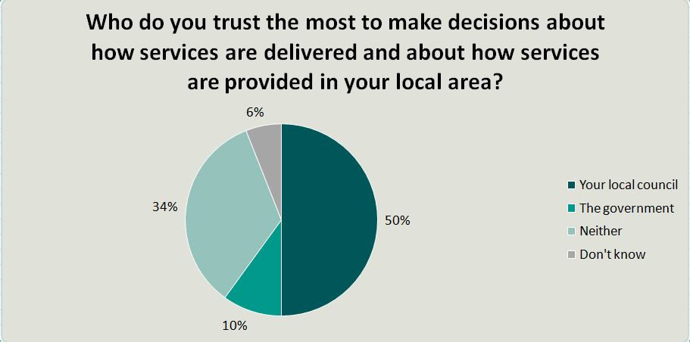
Trust relatively high Councils v Government

Slide 6
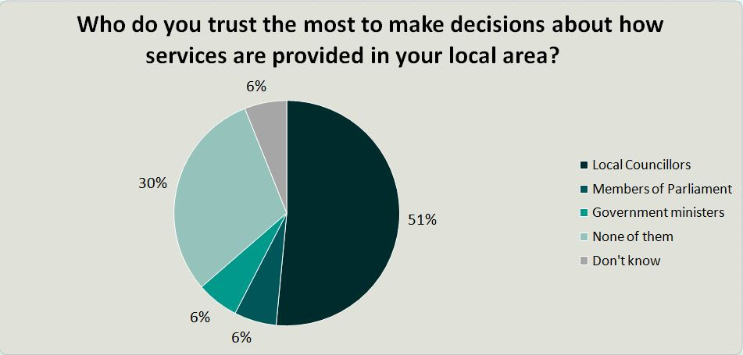
Trust relatively high in Councilors v others

Slide 7
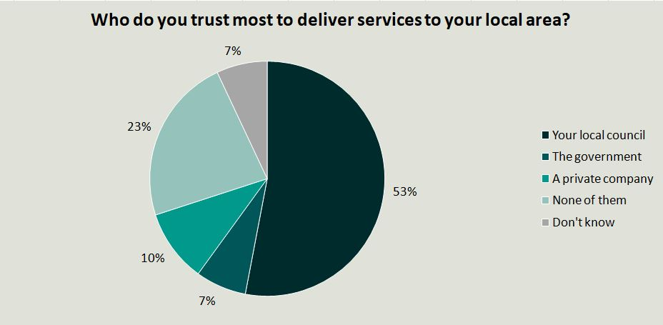
Trust high in Councils to deliver services

Slide 8
Who do you want to inspect building works?
Building inspectors employed by a local council used to perform all building inspections to check they complied with the approved plans and health and safety standards. Now, private employed consultants engaged by the developer mostly conduct these inspections.
Which of the following is closest to your view?
“Building inspections should be carried out by inspectors employed by the local council.”
“Building inspections should be carried out by private inspectors.”
“Don’t know”

Slide 9
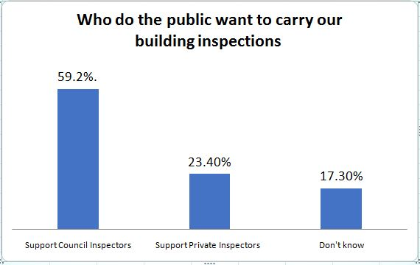
Who do you want to inspect building works

Slide 10
Who do you want to inspect building works?
Key points
  Three times as many voters support reverting to Council inspections than keeping the current regime of private inspection.
  Support among Conservative voters for Council inspectors is 63.8% which is higher than Labour voters at 59.5 % and the average at 59.2%.

Slide 11
A new power for Council to intervene?
When provision of housing by registered social landlords or private contractors are found to be clearly failing by the local community, the local council should have the power to intervene.
  Strongly Support
  Somewhat support
  Neither support nor oppose
  Somewhat oppose
  Strongly oppose
  Don’t know

Slide 12
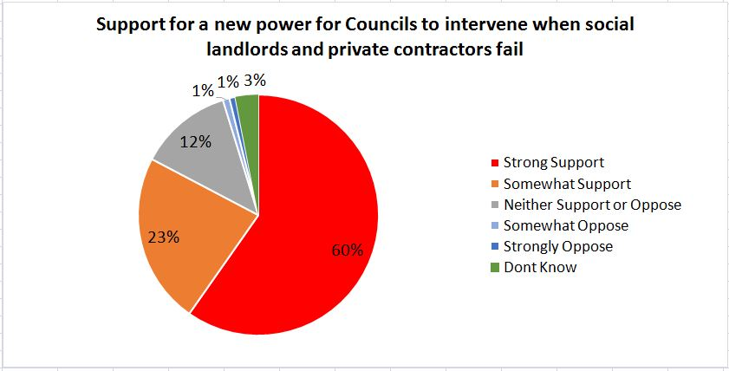
A new power for Council to intervene?

Slide 13
A new power for Council to intervene?
Key points
Total support 83.4%
Support among Conservative voters 88.3%
Support amongst Labour voters 84.3%
Support is slightly higher for the stronger intervention power

Slide 14
Public feel “loss of control” is the key issue
Survation research has shown consistently that the public want services that they see the public see as essential for their lives must be publicly owned. This applies to Rail and buses, utilities as well as Council provided services.
A major series of focus groups research work undertaken for TULO in 2013 indicated that the loss of control and accountability over costs and services they relied upon was the key for public ownership.
The 79% public believe in their taxes being spent at the local level which open the way for a major shift in provision of public services in the future.
Developing a model of local public services that is driven by public satisfaction with the service is the key challenge.
Survey of satisfaction across different services can model help support a model based on what the public think.

Slide 15
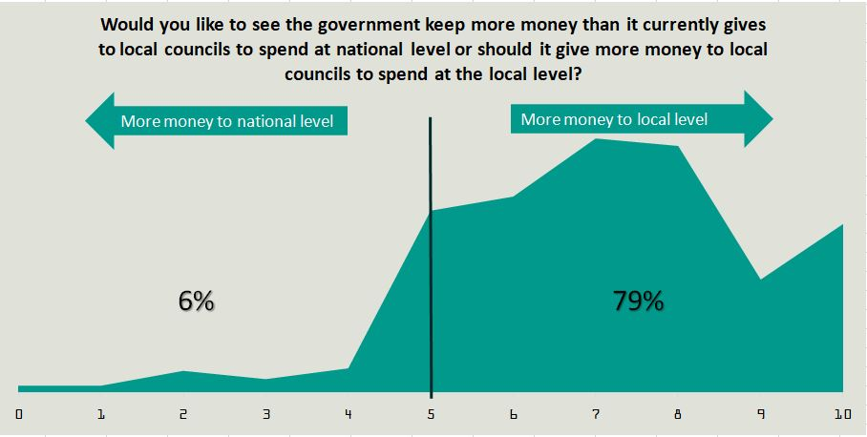
Should Government give Councils more funds?

Slide 16
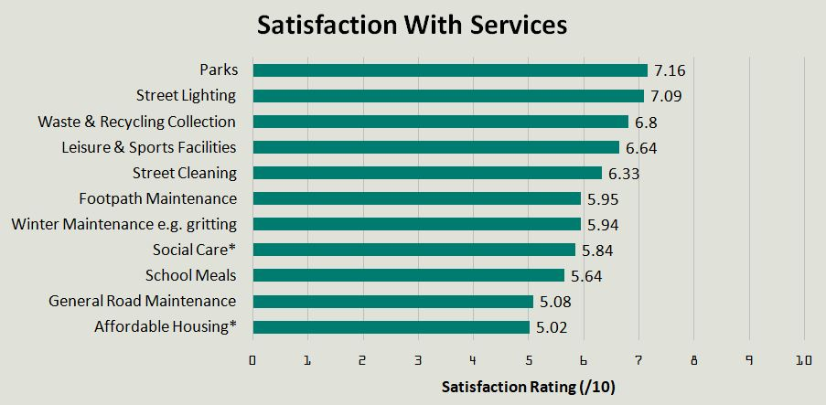
Performance of Councils services positive

Slide 17
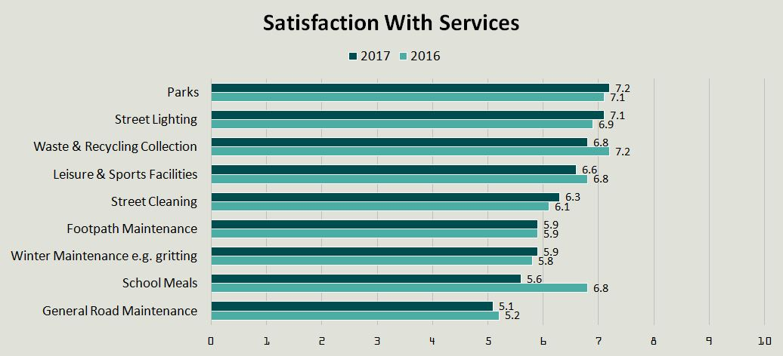
Performance mostly steady on last year

Slide 18
For more information
Paul Smith
paul.smith@survation.com

